Slide 1
Building Office Add-ins for Microsoft Outlook
Add-in Commands and Dialogs

Slide 2

Add-in Commands and Dialogs
Add-in Commands
ExecuteFunction Actions
Dialogs
Notes:
In this unit, you'll learn how to create add-in commands and work with dialogs to display information, or prompt the user for input.

Slide 3
Add-in commands
Add-in commands
Add-in commands provide an easy way to customize the default Office user interface (UI) with specified UI elements that perform actions.
Add-in commands are configured in the VersionOverrides element of an Add-in manifest.
Add-in commands can extend existing context menus and ribbon tabs/groups or create entirely new custom ribbon tabs/groups.
ExtensionPoint element
The ExtensionPoint element defines where Add-in commands should appear in the Office UI, including in an existing ribbon tab (OfficeTab), a custom tab (CustomTab), or in a context menu from right-clicking in the Office UI (OfficeMenu).
Add-in commands support button and menu controls. Buttons perform a single action and menus provide a submenu of actions.
Commands actions
ShowTaskpane is the most common action for an add-in command. It is used to launch the Add-in in a task pane. Using an add-in command to launch an Add-in is considered a best practice and is incorporated in most Office Add-in templates/generators.
ExecuteFunction is an action that allows an add-in command to execute some script in the background without display any UI. This type of command requires a FunctionFile to be defined in the manifest.
Notes:
Add-in commands provide an easy way to customize the default Office user interface (UI) with specified UI elements that do actions.
Add-in commands are configured in the `VersionOverrides` element of an add-in manifest.
Add-in commands can extend existing context menus, ribbon tabs and groups, or create new custom ribbon tabs and groups.
### ExtensionPoint element
The `ExtensionPoint` element defines where add-in commands should appear in the Office UI, including in an existing ribbon tab (*OfficeTab*), a custom tab (*CustomTab*), or in a context menu available by right-clicking in the Office UI (*OfficeMenu*).
Add-in commands support button and menu controls. Buttons do a single action and menus provide a submenu of actions.
### Commands actions
The `ShowTaskpane()` action is the most common for an add-in command. It's used to launch the add-in in a task pane. Using an add-in command to launch an add-in is considered a best practice and is incorporated in most Office add-in templates and generators.
The `ExecuteFunction` action allows an add-in command to execute some script in the background without displaying any UI. This type of command requires a `FunctionFile` to be defined in the manifest.

Slide 4
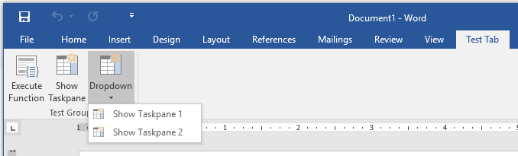
Add-in command in manifest
<ExtensionPoint xsi:type="PrimaryCommandSurface"> <CustomTab id="Contoso.Tab1"> <Group id="Contoso.Tab1.Group1"> <Label resid="Contoso.Tab1.GroupLabel" /> <Control xsi:type="Button” id="Contoso.FuncBtn"> <Label resid="Contoso.FuncBtn.Label" /> <Action xsi:type="ExecuteFunction"> <FunctionName>writeText</FunctionName> </Action> </Control> <Control xsi:type="Button" id="Contoso.TaskpaneBtn"> <Label resid="Contoso.TaskpaneBtn.Label" /> <Action xsi:type="ShowTaskpane"> <TaskpaneId>MyTaskPaneID1</TaskpaneId> <SourceLocation resid="Contoso.TP1.Url" /> </Action> </Control> <Control xsi:type="Menu" id="Contoso.Menu"> <Label resid="Contoso.Dropdown.Label" /> <Items> <Item id="Contoso.Menu.Item1"> <Label resid="Contoso.Item1.Label"/> <Action xsi:type="ShowTaskpane"> <TaskpaneId>MyTaskPaneID1</TaskpaneId> <SourceLocation resid="Contoso.TP1.Url" /> </Action> </Item> <Item id="Contoso.Menu.Item2"> <Label resid="Contoso.Item2.Label"/> <Action xsi:type="ShowTaskpane"> <TaskpaneId>MyTaskPaneID2</TaskpaneId> <SourceLocation resid="Contoso.TP2.Url" /> </Action> </Item> </Items> </Control>
1
2
1
2
3
3
1
2
1
2
*Parts of manifest omitted for readability
Notes:
Let's explore how the different elements in the add-in manifest map to the rendered elements in the Outlook user experience.
The following image includes contains an image of an Office client application on the left and a condensed version of an add-in manifest file on the right:
The manifest starts with the `ExtensionPoint` element that contains all customizations defined for the Office ribbon:
The entire contents of the `ExtensionPoint` element define the custom tab in the ribbon and all buttons in the tab:
Each button in the ribbon is defined using a `Control` element. A control can be different types, defined in the `xsi:type` property. All the controls in this ribbon are buttons:
Within a control, developers can define *actions* or *items*. An `Action` element is used to do an action, such as showing a task pane or executing a custom function.
The `Items` collection allows developers to add additional menu items to the ribbon button as shown in the following image. Notice each sub menu item also has a `Action` element as well:

Slide 5
ExecuteFunction Actions
manifest.xml
fnFile.html
<FunctionFile resid="Contoso.FnFile.Url" /> ...
<Control xsi:type="Button" id="Contoso.FnBtn"> <Label resid="Contoso.FnBtn.Label" /> <Icon> <bt:Image size="16" resid="Contoso.FnBtn.Icon" /> <bt:Image size="32" resid="Contoso.FnBtn.Icon" /> <bt:Image size="80" resid="Contoso.FnBtn.Icon" /> </Icon> <Action xsi:type="ExecuteFunction"> <FunctionName>doStuff</FunctionName> </Action> </Control> ...
<Resources> <bt:Urls> <bt:Url id="Contoso.FnFile.Url” DefaultValue="https://aka.ms/FnFile.html" /> ...
<script>
(function () { // Must call Office.initialize
Office.initialize => (reason) { // Initialize stuff
};
})();
// Function must be global
function doStuff(event) {
// Do stuff with Office.js
}
</script>
Notes:
The `ExecuteFunction` add-in command action enables developers to create custom functions, defined in JavaScript, to execute when a button is selected in the ribbon.
First, define the function in a script file. For example, add the following code to a new file in your add-in named **fnFile.html**:
To call the function, use the `ExecuteFunction` action type in the add-in manifest to call the function when the custom button is selected:

Slide 6
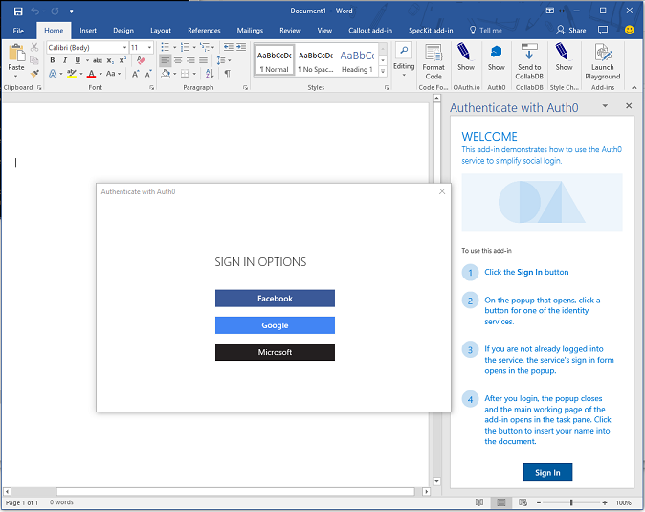
Dialogs
The Dialog API enables a dialog box to be opened from an Office Add-in and is an extension of the UX you can customize in Office.
A primary scenario for the Dialog API is to enable authentication with 3rd party providers, where app domains might not be predictable or displayable in a frame.
The Dialog API can provide additional screen real estate for elements difficult to view in a traditional task pane or content Add-in.
The Dialog API must be launched with a known app domain, but can immediately go to any website (or other resource) that uses HTTPS.
Notes:
The Dialog API is an extension of the user experience developers can customize in Office. Developers can use it to open dialogs from custom add-ins that interact with the user and the custom add-in user experience.
The primary scenario for the Dialog API is authentication with third-party providers. Most identity providers prevent their sign-in experiences from being displayed in an Iframe due to click-jacking concerns. This is troublesome with an add-in as they are displayed in Iframes in some of the clients such as the web versions of Office client applications.
Another challenge with authentication scenarios is predicting the domains that will need to load. In federated sign-in scenarios the potential list of domains could be endless, which again is troublesome in an add-in where all domains need to be registered in the manifest.
It's important to note that Office offers a single sign-on experience specific for Microsoft identities. If your add-in requires data about the Office user or their resources accessible through Microsoft Graph, such as Office 365 or OneDrive, Microsoft recommends you use the single sign-on API whenever you can. If you use the APIs for single sign-on, then you won't need the Dialog API.
Beyond authentication, the Dialog API can provide additional screen real estate for elements difficult to display in a traditional task pane of content add-in. A good example would be hosting a video that would be too small if confined to a task pane
The Dialog API can display any HTTPS web page, but it must be launched to an app domain first and then redirect.

Slide 7
Opening dialogs
Office.context.ui.displayDialogAsync("<URL />", options, optionalCallback);
URL
The dialog should initially open to a page hosted from an app domain (as defined in manifest).
The dialog can display any page that is hosted securely (HTTPS).
Options
Display options include dialog height and width (in % of device screen), which by default are 80% of the height and width of the device screen.
A displayInIframe option can be set to display as a floating iframe rather than an independent window (in clients that support this), which makes it open faster.
Optional Callback
The optional callback allows a host page (the page that opens the dialog) to listen for messages from dialog.
Notes:
Open a dialog using the `diaplayDialogAsync()` method from an Office add-in:
The `displayDialogAsync()` method accepts three parameters:
- The `<URL />` is the page to be displayed in the dialog. It most initially is a page hosted from an app domain as defined in the manifest. However, the page can immediately redirect to a different page.
- The `options` parameter allows the developer to modify the size of the dialog. By default, the dialog will display as 80% of the height and width of the device screen. The values for height and width are expressed as percentage of the device screen.
Developers can optionally set the `displayInIframe` property in the options. Setting this to `true` will cause the dialog to display as a floating Iframe rather than an independent window (in clients that support this), which makes it open faster.
- The `optionalCallback` allows the add-in's host page to respond to messages and events from the dialog.

Slide 8
Dialog input/output
/******* Start Host page script *******/
// Open the dialog passing the parameter id=123 let dialog = null; Office.context.ui.displayDialogAsync('https://domain/popup.html?id=123’, {height: 45, width: 55}, function(result) { dialog = result.value; // Listen for messages coming from the dialog dialog.addEventHandler( Microsoft.Office.WebExtension.EventType.DialogMessageReceived, processMessage); });
function processMessage(arg) { // Log the message send from the dialog and close the dialog console.log(arg.message); dialog.close(); } /******* End Host page script *******/
/******* Start Dialog page script *******/ // Dialog must call Office.initialize Office.initialize = function() { // Send the parent/host a message Office.context.ui.messageParent(‘Hello from the dialog!!!‘); } /******* Start Dialog page script *******/
Points of interest
The primary way to pass information to a dialog is through local storage (ex: window.localStorage) or URL parameters in the dialog URL.
A dialog can pass messages back to the host by calling Office.context.ui.messageParent and sending either a Boolean or string value to the host page.
The messageParent function can only be called on a page with the same domain (including protocol and port) as the host page.
The host page must “listen” for messages by subscribing to the DialogMessageReceived handler.
Notes:
The primary way to pass information to a dialog is through the browser's local storage (`window.localStorage`) or through URL parameters in the dialog URL. In this sample, the host page is passing an ID of "123" to the dialog via a url parameter.
A dialog can pass messages back to the host by calling `Office.context.ui.messageParent` to send either a Boolean value or a string message to the host page. At the bottom of the sample, you can see the dialog script where it's passing the message "Hello from the dialog!!!" to the parent.
The `messageParent()` method can only be called on a page with the same domain (including protocol and port) as the host page.
The host page must listen for messages by subscribing to the `DialogMessageReceived` handler. In the sample, the host page registers this handler using the `processMessage` function, where it logs the message to the console.

Slide 9
Demo
Notes:
In this demo, we will explore add-in commands, dialogs, and function files in a mail add-in for Outlook

Slide 10

Summary
Add-in commands provide ways to initiate specific add-in actions from the ribbon by adding buttons or drop-down menus
Outlook supports add-in commands with ExecuteFunction actions for operations that don’t need a UI
The dialog API in Office.js provides a safe dialog for capturing/displaying information that may not work in a tradition add-in UX

Slide 11
Reading further
Add-in commands
https://docs.microsoft.com/en-us/office/dev/add-ins/outlook/add-in-commands-for-outlook
Add-in Dialogs
https://docs.microsoft.com/en-us/javascript/api/office/office.ui?view=office-js#displaydialogasync-startaddress--options--callback-
ExecuteFunction Actions
https://docs.microsoft.com/en-us/outlook/add-ins/add-in-commands-for-outlook#what-ux-shapes-exist-for-add-in-commands

Slide 12
Thank you

